Slide 1
Artificial intelligence VII
Maria Markosova

Slide 2
Last lecture
B. networks diagnostic model, d – separation.
Introduction to the time series, basic concepts.
Analysis of trend – MA,

Slide 3
Outline
Exponential smoothing.
Linear trends.
Periodicity, seasonality in time series – methods: box plot, correlation coefficient, triple exponential smoothing.
Power spectrum.

Slide 4
Single moving average (MA, SMA)
We average smaller set of the data as we move through the series using a window of certain length (for example 3 time units)
We replace the data in a window by the average, this simultaneously smoots the data
smoothed value at the time t
Measurements at t-i
N – window lenght
MA is able to detect simple trends, such as linear.

Slide 5
Single moving average - grafically
Y(t)
t

Slide 6
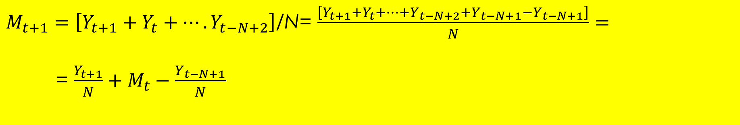
Why in MA we need not to calculate the average from all of the data in the window? How to calculate knowing ?
$M_{t+1}=\left[Y_{t+1}+Y_{t}+….Y_{t−N+2}\right]$/N= $\frac{\left[Y_{t+1}+Y_{t}+…+Y_{t−N+2}+Y_{t−N+1}−Y_{t−N+1}\right]}{N}=$
= $\frac{Y_{t+1}}{N}+M_{t}−\frac{Y_{t−N+1}}{N}$
Another version of MA is, that we take the same number of the measuremands forward and backward. This MA is called CMA central moving average.

Slide 7
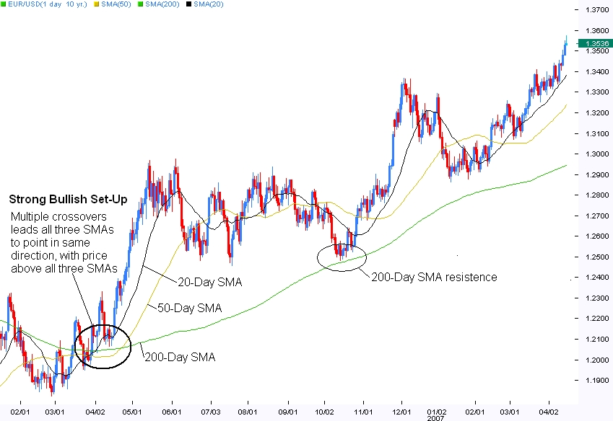
MA with the window lenght 20, 50 and 200 time units to the past.

Slide 8
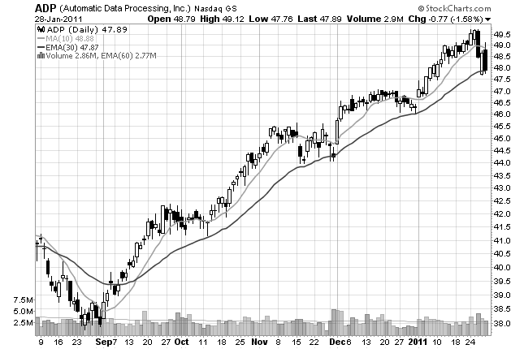
Here we see MA with the window 10 days (quick MA) and MA with the window 30 days(slow MA). Crossover points of the slow and quick MA is a trend change indicator. Look at the previous fig too.

Slide 9
Double moving average (DMA) for the linear trends
DMA is the same as MA, but done from the data gained after the first smoothing of the measured data by MA.
DMA is mostly used to find linear trends, but there are programs able to predict the values one time unit further very well, and are able to classify other types of significant trends as well.
DMA: Resulting data, smoothed by the first MA are smoothed again by MA.
Problem: lack of the data after the first usage of MA

Slide 10
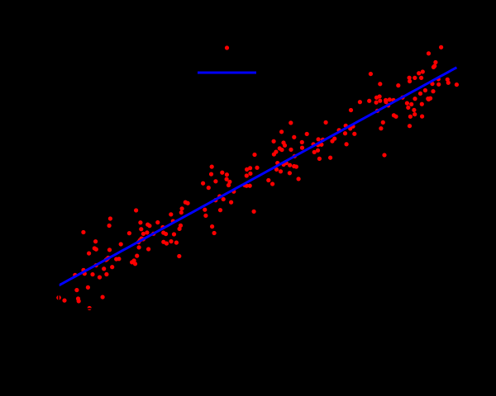
Linear trends
If we find, that after the smoothing procedure the trend in the time series is linear, we can approximate it by a line. The parameters are found with a help of linear regression.
Measurable value
y
Measured value with coordinates
Obr . 5. Time series with linear trend.
x(time for example)

Slide 11


Linear regression – with a help of this method we can approximate the measured data by a line with the parameters a,b.
Equation of a line with parameters a,b. To specify a line, we need to calculate the parameters.
Formulae for the parameter calculation. n is a number of measured data points, sum runs trough all of the measured data points.

Slide 12
Comment
Line approximating the data with parameters calculated by the above mentioned formulae is such that the mean square error is as small as possible. That is why it is a good linear fit to the measured data, even if the data are not linear.

Slide 13
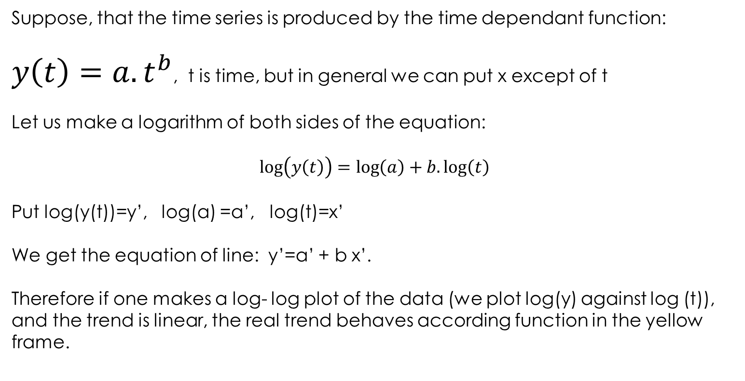
Why is useful to make the trend linear
Suppose, that the time series is produced by the time dependant function:
$y\left(t\right)=a.t^{b}$, t is time, but in general we can put x except of t
Let us make a logarithm of both sides of the equation:
$$\log\left(y\left(t\right)\right)=\log\left(a\right)+b.\log\left(t\right)$$
Put log(y(t))=y’, log(a) =a’, log(t)=x’
We get the equation of line: y’=a’ + b x’.
Therefore if one makes a log- log plot of the data (we plot log(y) against log (t)), and the trend is linear, the real trend behaves according function in the yellow frame.

Slide 14
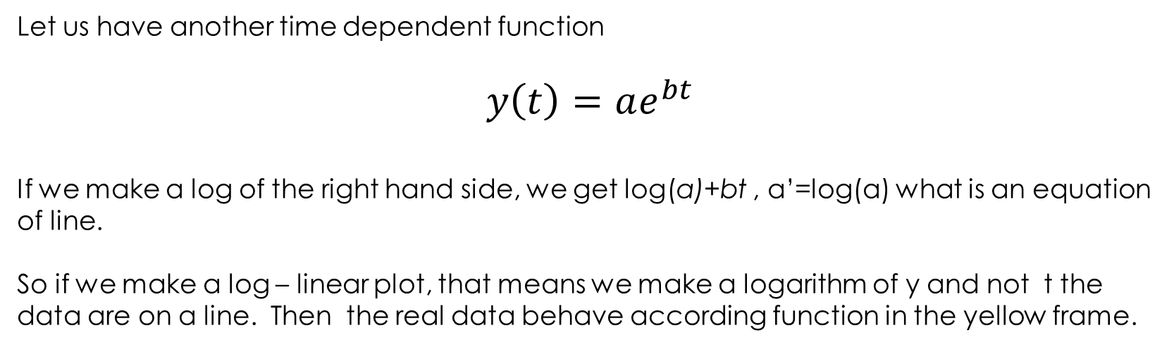
Let us have another time dependent function
$$y\left(t\right)=ae^{bt}$$
If we make a log of the right hand side, we get log(a)+bt , a’=log(a) what is an equation of line.
So if we make a log – linear plot, that means we make a logarithm of y and not t the data are on a line. Then the real data behave according function in the yellow frame.
log – linear plot
log – log plot
log y
log y
t
log t

Slide 15
Single exponential smoothing
Let us suppose that : , where b is a trend slowly changing with time and is an “error ”, changing quickly with time.
We calculate “moving average “ but supposing that the observations which are closer in time to the current time have greater weight, then the more distant observations..
is a smoothed value at the time t, is a smoothing constant and , , and y are observed , measured values.

Slide 16
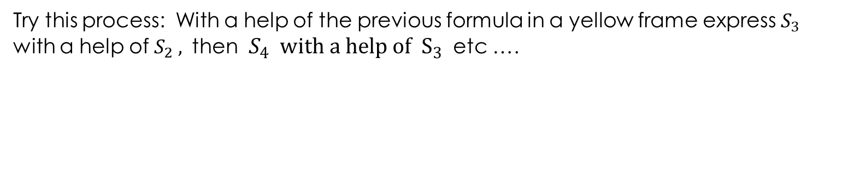
Why „exponential“ smoothing?
Try this process: With a help of the previous formula in a yellow frame express $S_{3}$
with a help of $S_{2} ,$ then $S_{4} with a help of S_{3}$ etc ….
Additions from the more distant measured values are exponentially decreasing.
Derive $S_{5}$ at home.

Slide 17
Advantage of the single exponential smoothing and estimate.
- SES is a best method for the one step forecast
estimate from the praxis: from the praxis it is for example known that alpha value around 0.3 is usually the best one for the series in question.
estimate from the data: we try values with certain step, we calculate the smoothed data and the mean square error . having the smallest mean square value is the best.
visual estimate: Plot the smoothed series (with the given ) together with measured values and compare visually. Good for the approximate estimate.

Slide 18
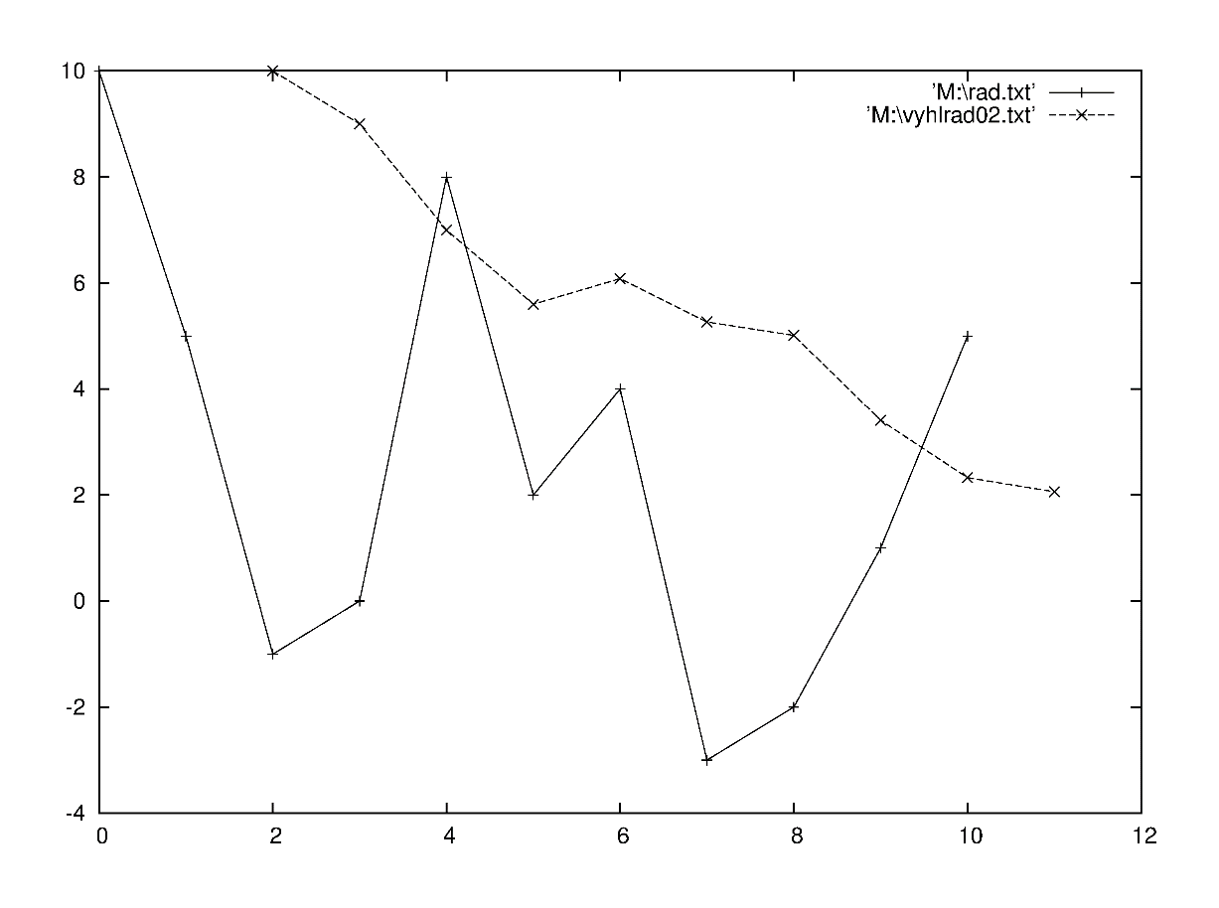

Example single exponential smoothing
Measured time series
10
5
-1
0
8
2
4
-3
-2
1
5
Error is the mean square error
error

Slide 19
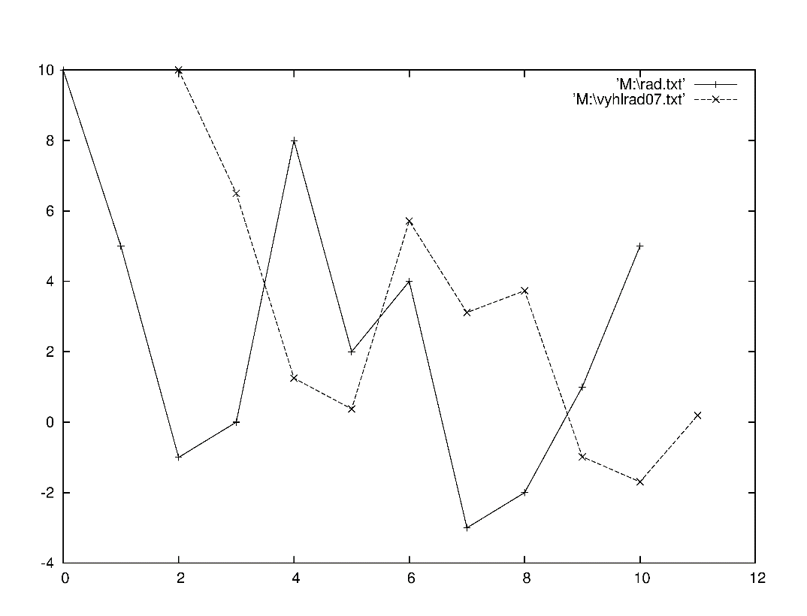

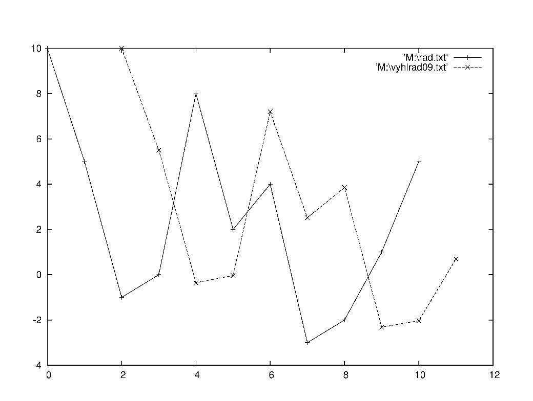

error
error

Slide 20
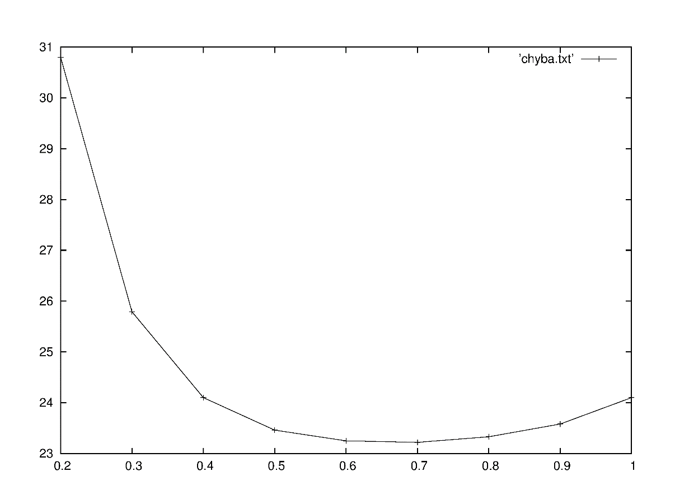
Dependence of the error on the α value.
chyba
error
minimum
alfa

Slide 21
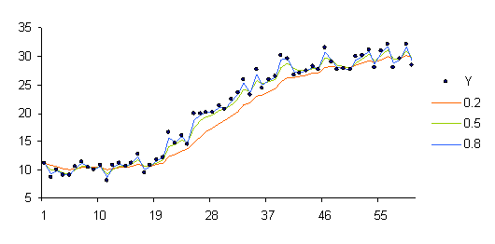
How SES works : measured data
alfa=0.2
alfa=0.5
alfa=0.8

Slide 22
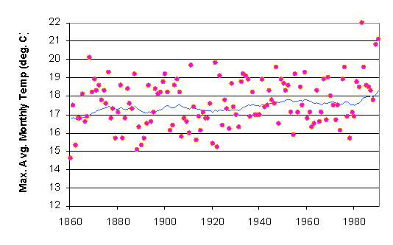
Temperature measurements in London through several tens of years. Each point exhibits an average monthly temperature.
Line : smoothed data

Slide 23
Double exponential smoothing (DES)
To the previous smoothed value one adds a trend at the time t-1
Update of the trend
- Different possibilities for the b choice.

Slide 24
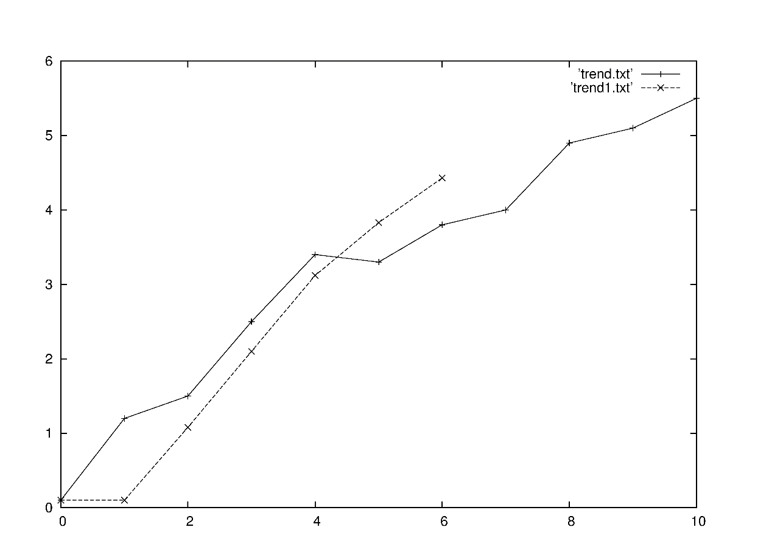
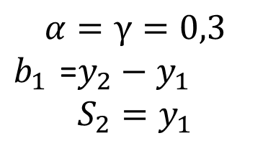
DES example
Initial conditions
Red points – time series
Black points – part of the smoothened series ).
Initial conditions can be chosen differently. For a long time series this is not that important, because the influence of the initial conditions on the values of the smoothed series decreases exponentialy.
Initial series
0.1
1.2
1.5
2.5
3.4
3.3
3.8
4.2
4.9
5.1
5.5

Slide 25
Forecast with the DES
One time step forecast
and are fitted. The best fit is the one giving the least mean square error
If there is a trend in the time series, DES performs better then SES.
m time steps forecast
DSE fits the trend better then SSE, because it is able to fit with the with lower mean square error

Slide 26
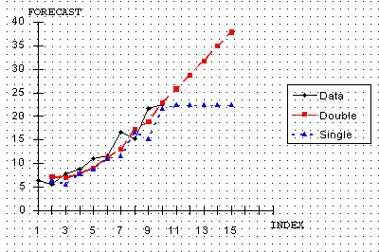
Forecasting - examples
Double exponential smoothing versus single exponential smoothing.

Slide 27
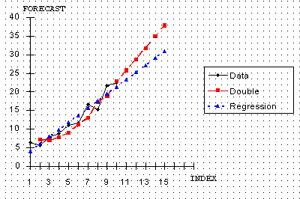
Double exponential smoothing versus linear regression forecast.

Slide 28
Periodicity (seasonality) analysis in the time series
Seasonal part in the time series:
1. Additive
2. Multiplicative
Aditive periodicity example : Sale (sum of prices) of a certain toy has a peak at December, but each year this peak price 1 million dollars is added.
Multiplicative periodicity example: Sale of some another toy has also peak at December, but this peak is each year multiplied by the factor 1.4.

Slide 29
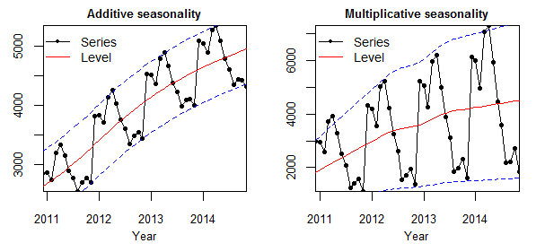
Additive versus multiplicative time series example (Nikolaos Kourentzes home page , Lancaster University)
Sale

Slide 30
How to reveal seasonality in time series?
Draw the time series in time, if there are some significant seasonal changes, they are visible by eye. We can see it even better if subtracting the trend (if the type of the trend is known).
If the period of the seasonal changes is known, to draw one period might be useful, because one can see more refined seasonal changes. We can copy more periods one above the other and average. This procedure smoothens the noise. We can subtract the trend, smoothen the series etc.
Multiple box plot.
Find the dependence of the autocorrelation coefficient on the time interval.
Triple exponential smoothing .

Slide 31
Time dependence of the time series
To see how the time series behaves in time is the first step one need to identify. Then
- try to fit the series by some function
- try to smoothen the time series
- if there is a visible trend, try to find the trend and subtract it from the measured
data.
-draw the time behavior of the time series with the subtracted trend
-use triple exponential smoothing to fit the seasonal parts of the time series

Slide 32
Example how to deal with seasonality
Series: Two year measurement of how many lunches were sold in the school restaurant
1000
MA smoothing
500
100
Quarters of year

Slide 33
1. From the time behavior of the time series one sees, that there is a linear trend and a multiplicative periodicity.
2. Centered MA with the window a bit longer then the period smoothens the seasonal changes. Cyclic part, if there exists, is not usually touched. Fit the trend.
3. Subtract the trend and find an average multiplicative factor by coping January, February ….parts of the time series. Rescale and average the seasonal changes. The random part is inhibited by the averaging.

Slide 34
Seasonality in the complex time series.
concentation of certain chemical in the air
month
Heuristic knowledge: there are probable seasonal changings, but they are not easily visible

Slide 35
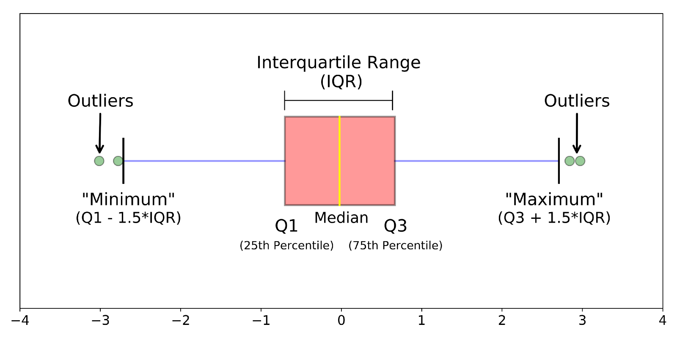
Box plot
A boxplot is a standardized way of displaying the distribution of data based on a five number summary (“minimum”, first quartile (Q1), median, third quartile (Q3), and “maximum”). It can tell you about your outliers and what their values are. It can also tell you if your data is symmetrical, how tightly your data is grouped, and if and how your data is skewed. (definition of Michael Galarnyk)
median : the middle value of the dataset.
first quartile (lower): the middle number between the smallest number (not the “minimum”) and the median of the dataset.
third quartile (upper): the middle value between the median and the highest value (not the “maximum”) of the dataset
Notes:
https://towardsdatascience.com/understanding-boxplots-5e2df7bcbd51

Slide 36
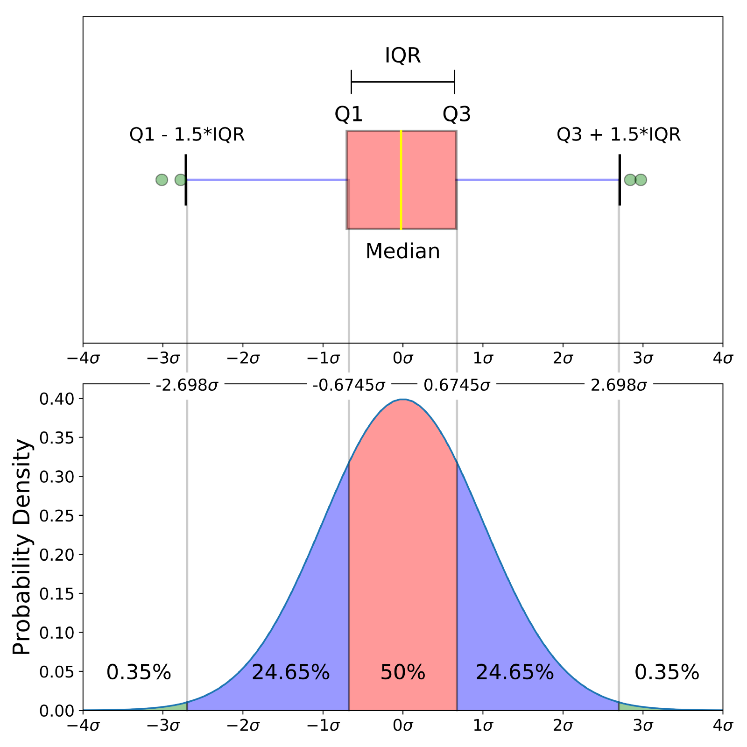
Box plot if the data are distributed normally
Probability density function (PDF): A PDF is used to specify the probability of the random variable falling within a particular range of values. This probability is given by the integral of this variable’s PDF over that range — that is, it is given by the area under the density function but above the horizontal axis and between the lowest and greatest values of the range

Slide 37
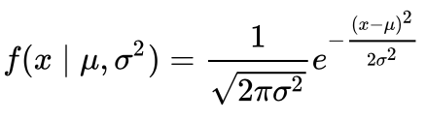

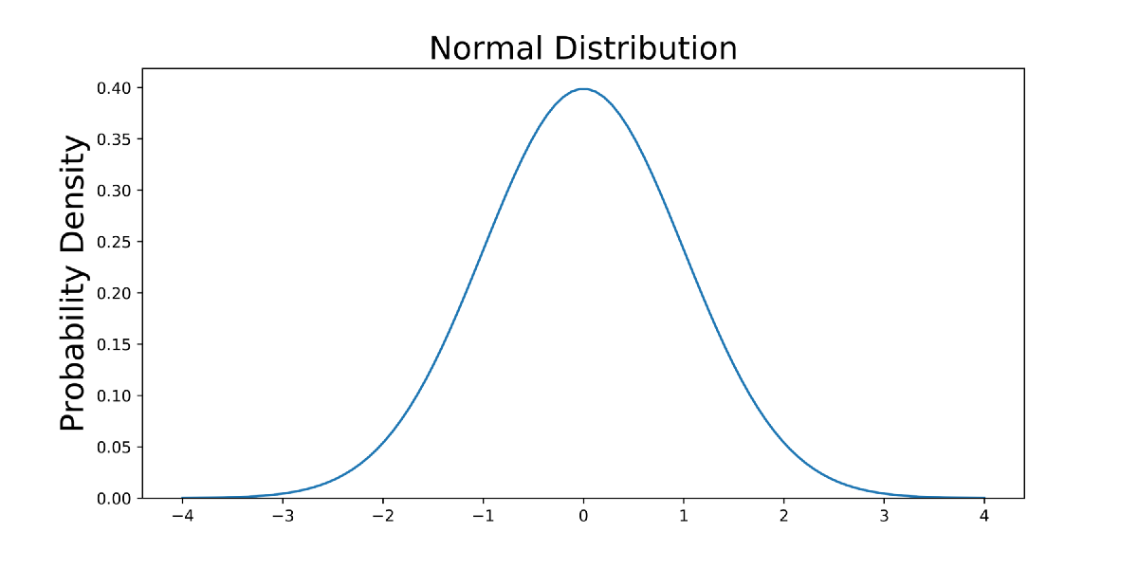
Example
Let us have the normal distribution. Its PDF is
Mean Standars deviation
Let mean is zero and the standard deviation is one, then PDF is

Slide 38
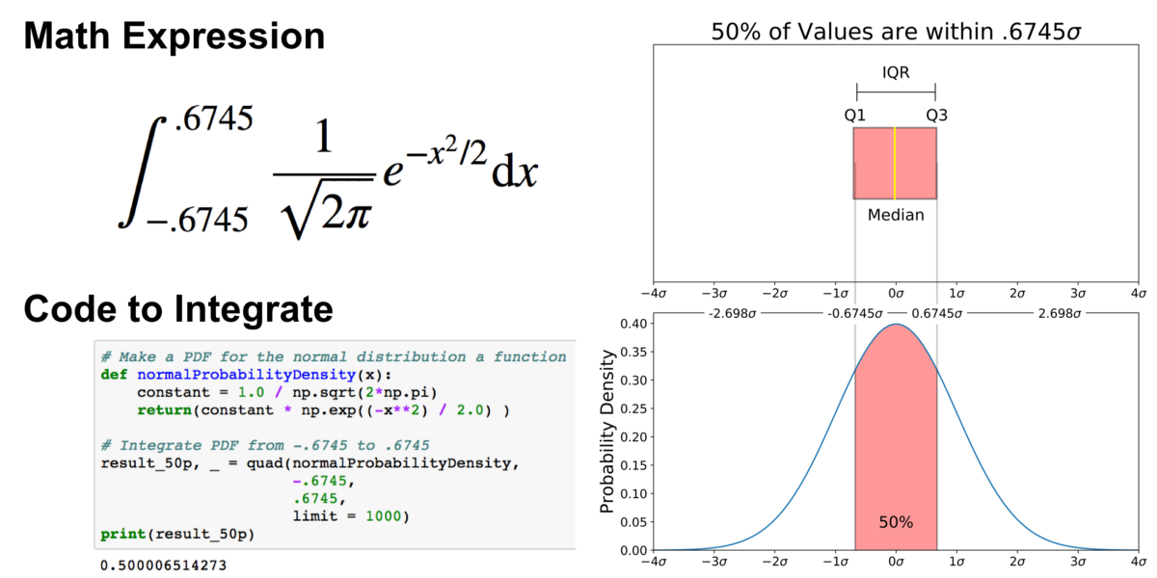
How to find quartils
Suppose we are interested in finding the probability of a random data point landing within the interquartile range .6745 standard deviation of the mean, we need to integrate from -.6745 to .6745.

Slide 39
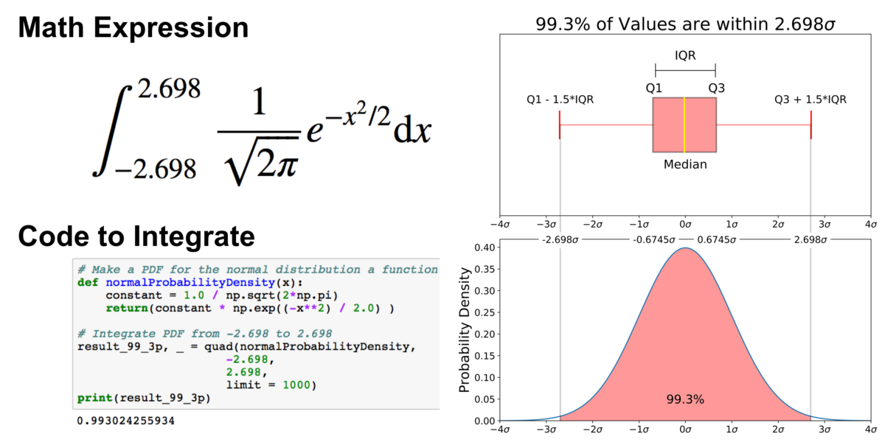
How to find minimum and maximum
Outliers are the remaining .7% percent of the data.
The distribution of the real data is not necessarily normal.

Slide 40
Box plot from the data
This technique enables one to summarize the data, so the seasonal changes are enhanced. One should know a heuristic estimate of the period.
Order the onetime unit data according the value, find the maximal and minimal value.
Find a median. 50 % of the data are above
median.
Find medians of upper and lower half of the data (upper and lower quartil)
Draw a line connecting maximum and minimum in the data and divide it by the median and quartil lines.
max
E
upper kvartil
median
Lower kvartil
100
min
50
One month
0

Slide 41
Back to our complex time series with the supposed hidden seasonality. Let us suppose, that the period is one year, because the concentration of the chemical depends on the temperature and the weather.
max
E
upper kvartil
median
Lower kvartil
100
min
50
For 1. month
0

Slide 42
Multiple box plot
E
150
100
50
For 4 months, seasonal changes are more clear
1
2
3
4

Slide 43


Autocorrelation coefficient
If the data are independent, this coefficient is close to zero
if there is a periodicity, for certain time intervals, which are equal to the period, the coefficient is maximal
value
Motivation:
time
$$Y_{l+2h}$$
$$Y_{l+h}$$
Calculate this sum for the time interval equal to the h= period.
l+2h

Slide 44
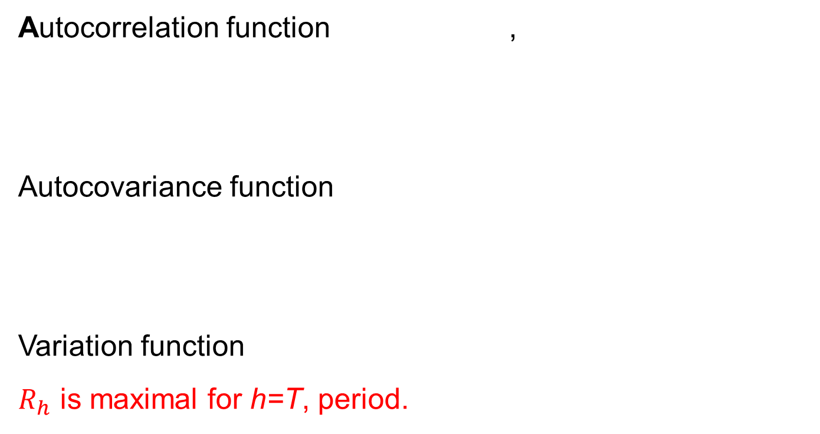
How to calculate an autocorrelation coefficient?
Autocorrelation function ,
Autocovariance function
Variation function
$R_{h}$ is maximal for h=T, period.
h=1,2,3,....,N, time interval

Slide 45
Triple exponential smoothing (TES) (multiplicative seasonality, Holt Winters method)
Technique which smoothes the data with trend and seasonality.
Suppose the series looks like this:
-overall smoothing
- trend smoothing
- seasonal smoothing
- m step forecast

Slide 46
Meaning of the variables
-y measured value, observation
-S smoothed observation
-b trend factor
-I seasonal factor
-t time
-F forecast
-L time lag, period, interval

Slide 47
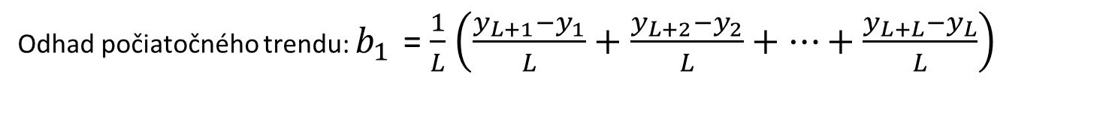
TES, multiplicative seasonality, initial conditions.
We need to know the period if we want to smoothen the series. Enough amount of the data is also necessary. Example – imagine, we have a 6 year measurement, the data are measured every several months, L=4 in one year. One year is the estimated period.
Initial trend estimate
y
year

Slide 48
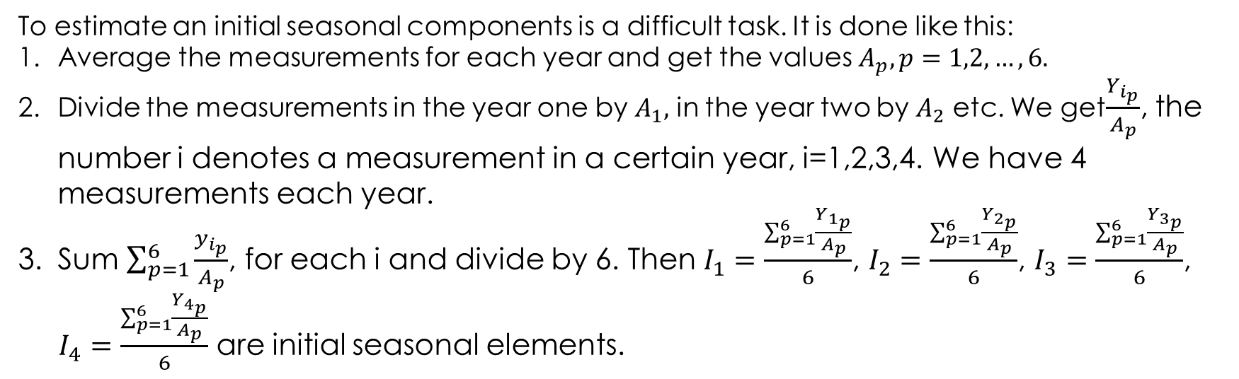
TES, multiplicative seasonality, initial conditions.
We have 6 year measurements during, L=4 .
To estimate an initial seasonal components is a difficult task. It is done like this:
Average the measurements for each year and get the values $A_{p}, p=1,2,…,6.$
Divide the measurements in the year one by $A_{1},$ in the year two by $A_{2}$ etc. We get$\frac{Y_{i_{p}}}{A_{p}}$, the number i denotes a measurement in a certain year, i=1,2,3,4. We have 4 measurements each year.
Sum $\sum_{p=1}^{6}{\frac{y_{i_{p}}}{A_{p}}}$, for each i and divide by 6. Then $I_{1}=\frac{\sum_{p=1}^{6}{\frac{Y_{1_{p}}}{A_{p}}}}{6}$, $I_{2}=\frac{\sum_{p=1}^{6}{\frac{Y_{2_{p}}}{A_{p}}}}{6}$, $I_{3}=\frac{\sum_{p=1}^{6}{\frac{Y_{3_{p}}}{A_{p}}}}{6}$,
$I_{4}=\frac{\sum_{p=1}^{6}{\frac{Y_{4_{p}}}{A_{p}}}}{6}$ are initial seasonal elements.
i is an order of measurement in one year. So i=1 means, that all first measurements in all 6 years are summed, i=2, second measurements in each year are summed etc.

Slide 49
Logic in seasonal components initialization
Average the data in each year.
y
Spočítame pomery prvých meraní voči priemerom v každom roku, druhých meraní , tretích meraní.... A spriemerníme cez všetky roky. Dostaneme tak priemerný koeficient ktorým sa líši prvé meranie v roku od priemeru, druhé meranie v roku od priemeru apod.
Calculate the ratios of the first measurements of the year against the year average, second measurements, third measurements .... And average these ratios over all years. This way we get an average coeficient by which the first measurement in a year differ from the average, the second measurements in a year from the average etc.
A3
y12
y14
y11
A2
A1
y13
year
Good news: This is rarely done by hand, commercial software do it for you automatically. This is just to show you how difficult it might be,

Slide 50
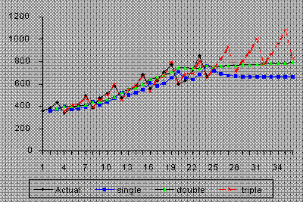
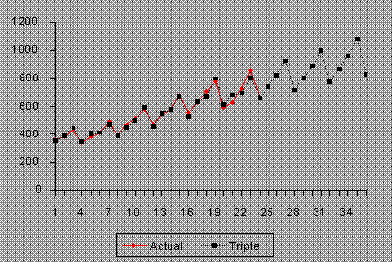
Functionality of the TES

Slide 51

Triple exponential smoothing (TES) (aditive seasonality )
Technique which smoothens the data with trend and the seasonality.
We suppose, the time series behaves like this:
overall smoothing
trend smoothing
seasonal smoothing
one step forecast
$$S_{t}$$
We will not speak how to set initial conditions here. These things are usually done by a commercial software. One can use also previous method in which the seasonal factors for different measurements in one year are the same.

Slide 52
Examples of the tasks on time series from the exam
We have a time series, whose values are governed by the model function:
Model function: y=0.3t*sin(t)+t. What is the trend and the seasonality, periodicity type of this time series?
Linear trend, multiplicative seasonality
How would you fit the series having an exponentialy growing trend if you have only a softvare for the line fitting?

Slide 53
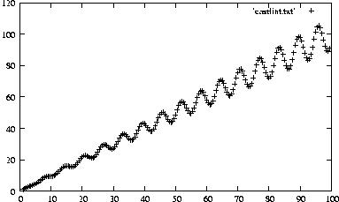
y=0.3t*sin(t)+t

Slide 54
Spectral analysis of the time series - power spectrum
Power spectrum (výkonové spektrum) is based on the Fourier transform of the autocorrelation function (ACF) of the time series.
autocorrelation function
Fourier tr. of the ACF
Power spectrum

Slide 55
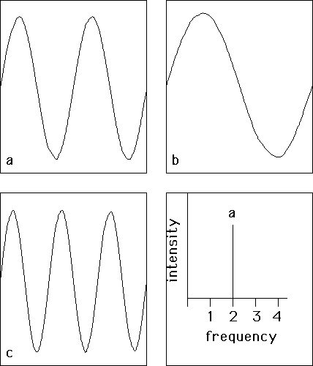
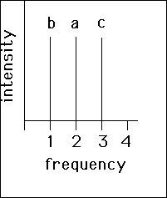
Periodic signals on the (0,1) interval and their power spectra.
f=1/T
f – frekvency
T- period

Slide 56
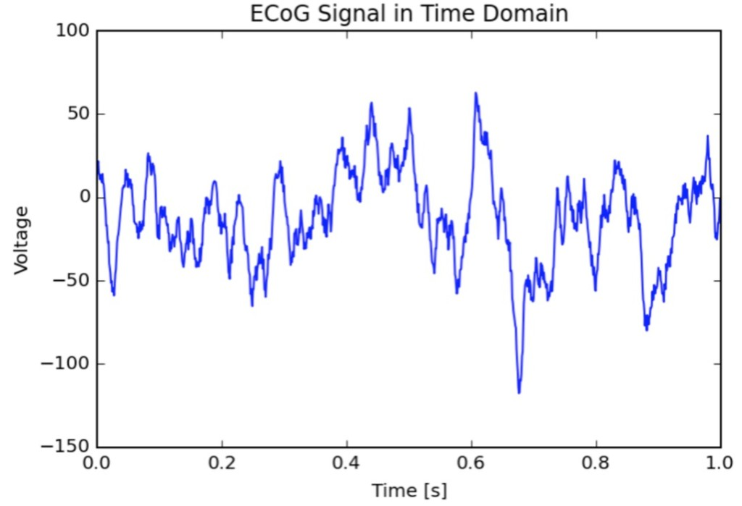
Example : time series –output of the electrode measuring the signal from the brain surface

Slide 57
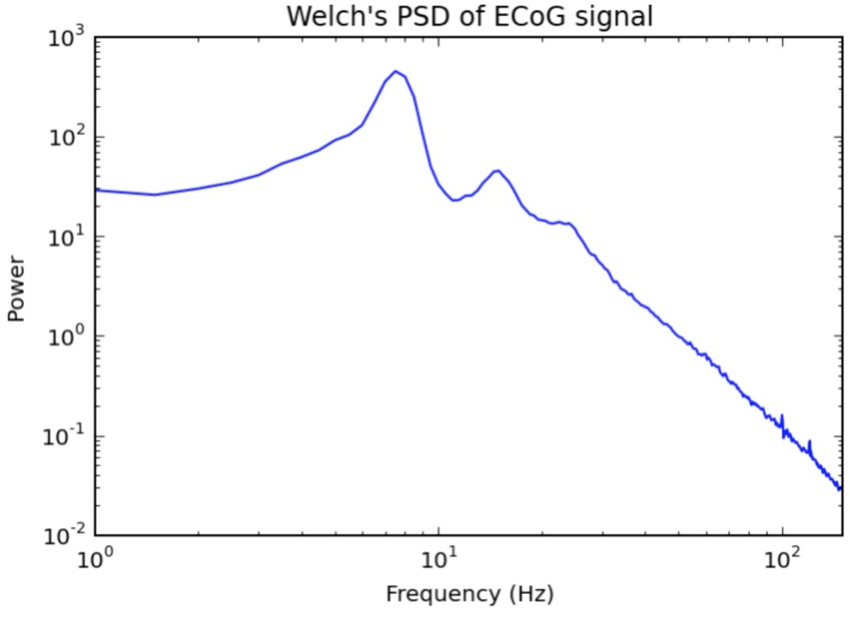
Power spectrum (vykonove spektrum) of the previous signal

Slide 58
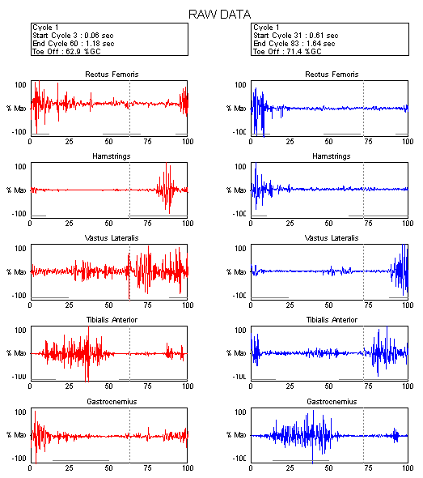

Slide 59
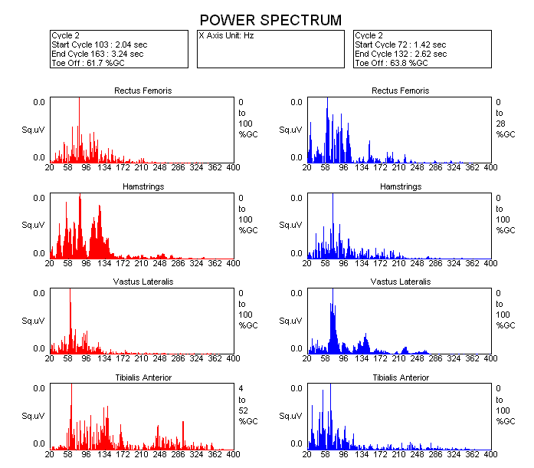

Slide 60
Time series analysis and modeling - summary
What to do in general:
1. Look how the time series looks, draw it
2. Find trend, seasonal, periodical changes, the rest.
3. Spectral analysis – frequency spectrum analysis of the
time series.
Find a good model of the time series. There are two
approaches:
-decomposition (model trend, periodicity by the appropriate functions….)
-Box-Jenkinsov approach (how are random parts of the time series correlated)

Slide 61
Stationary time series (stacionárny časový rad)
Definition: Time series is called stationary if it has folowing properties:
Finite variation
Constant average value
Autocorelation function independent on t, h, dependend only on (t-h).
variation
average value
- autocorrelation function

Slide 62
Examples of stationary and non stationary time series
Random walk:
Distance of the random walk from the beginning is , let =0. :
Let , where are independent steps with average value zero
and variation .
Then the autocorrelation function is:
Time series is not stationary

Slide 63
Time series with linear trend
Time series behaves like this
Average
This time series is not stationary, because the average value is time dependent.
That means, if the the average value of the time series is calculated from the data to the time t, it is different to the average calculated from the data to the time t+delta t.

Slide 64
White noise
White noise has a normal distribution with zero-th average value and variation . Autocorrelation function of the white noise is if h=0 and 0 elsewhere.
White noise creates a stationary time series.

Slide 65
Importance of the time series stationarity
All of the modern methods of the time series elaboration and analysis are working with the stationary time series.
Modern theory of the time series is about stationary time series.
3.. Commercial software often demands that the time series is stationary.
All of this means, we need a methods by which it is possible to make the time series stationary.

Slide 66

How to make the time series stationary?
There are several more or less heuristic methods.
If the series has a significant trend, find it and subtract the trend values from the series values. Check, whether the series is stationary.
If the trend is not significant enough, to remove it often helps to make the first difference of the time series.
From the series
create a new series
$$x_{2}−x_{1}$$

Slide 67
If the first difference does not remove the trend make a second difference
If we are successful in removing the trend, find the time series period and subtract the regular periodic changes from the time series values. For example by making a transformation :
To make the time series stationary is often problematic. But the good news is, the commercial software usually does the job for you.
If none of the previous methods are successful there are some more heuristic rules, which usually do the job,

Slide 68
Heuristic rules
If the time series has a trend and variation and both depend on time, make a logarithm of the time series values.
If there is no trend and variation is time dependent, logarithm of the time series values is not enough to make the series stationary .
Logarithm can help, if there is a trend and periodicity and the amplitude of the periodic changes is proportional to the time dependent average value (multiplicative periodicity).

Slide 69
Summary
Analysis of the trend – single, double exponential smoothing
Analysis of the periodicity, multiple box plot, autocorrelation coefficient, triple exponential smoothing.
Examples of the methods applications.
Power spectra.
Stationary time series.

Slide 70
Questions
Which of the following is an example of time series problem?
1. Estimating number of hotel rooms booking in next 6 months. 2. Estimating the total sales in next 3 years of an insurance company. 3. Estimating the number of calls for the next one week.
Solution: 1,2,3
b) Which of the following can’t be a component for a time series plot?
A) Seasonality B) Trend C) Cyclical D) Noise E) all can be
Solution: E

Slide 71
c) Which of the following is relatively easier to estimate in time series modeling?
A) Seasonality B) Cyclical C) No difference between Seasonality and Cyclical
Solution: A) seasonality is easier to estimate
6) Adjacent observations in time series data (excluding white noise) are independent and identically distributed (IID).
A) TRUE
B) FALSE
Solution: B

